Slide 1
CAN DEV
Employment
Equity
Group YYDS
February 4th, 2022

Slide 2


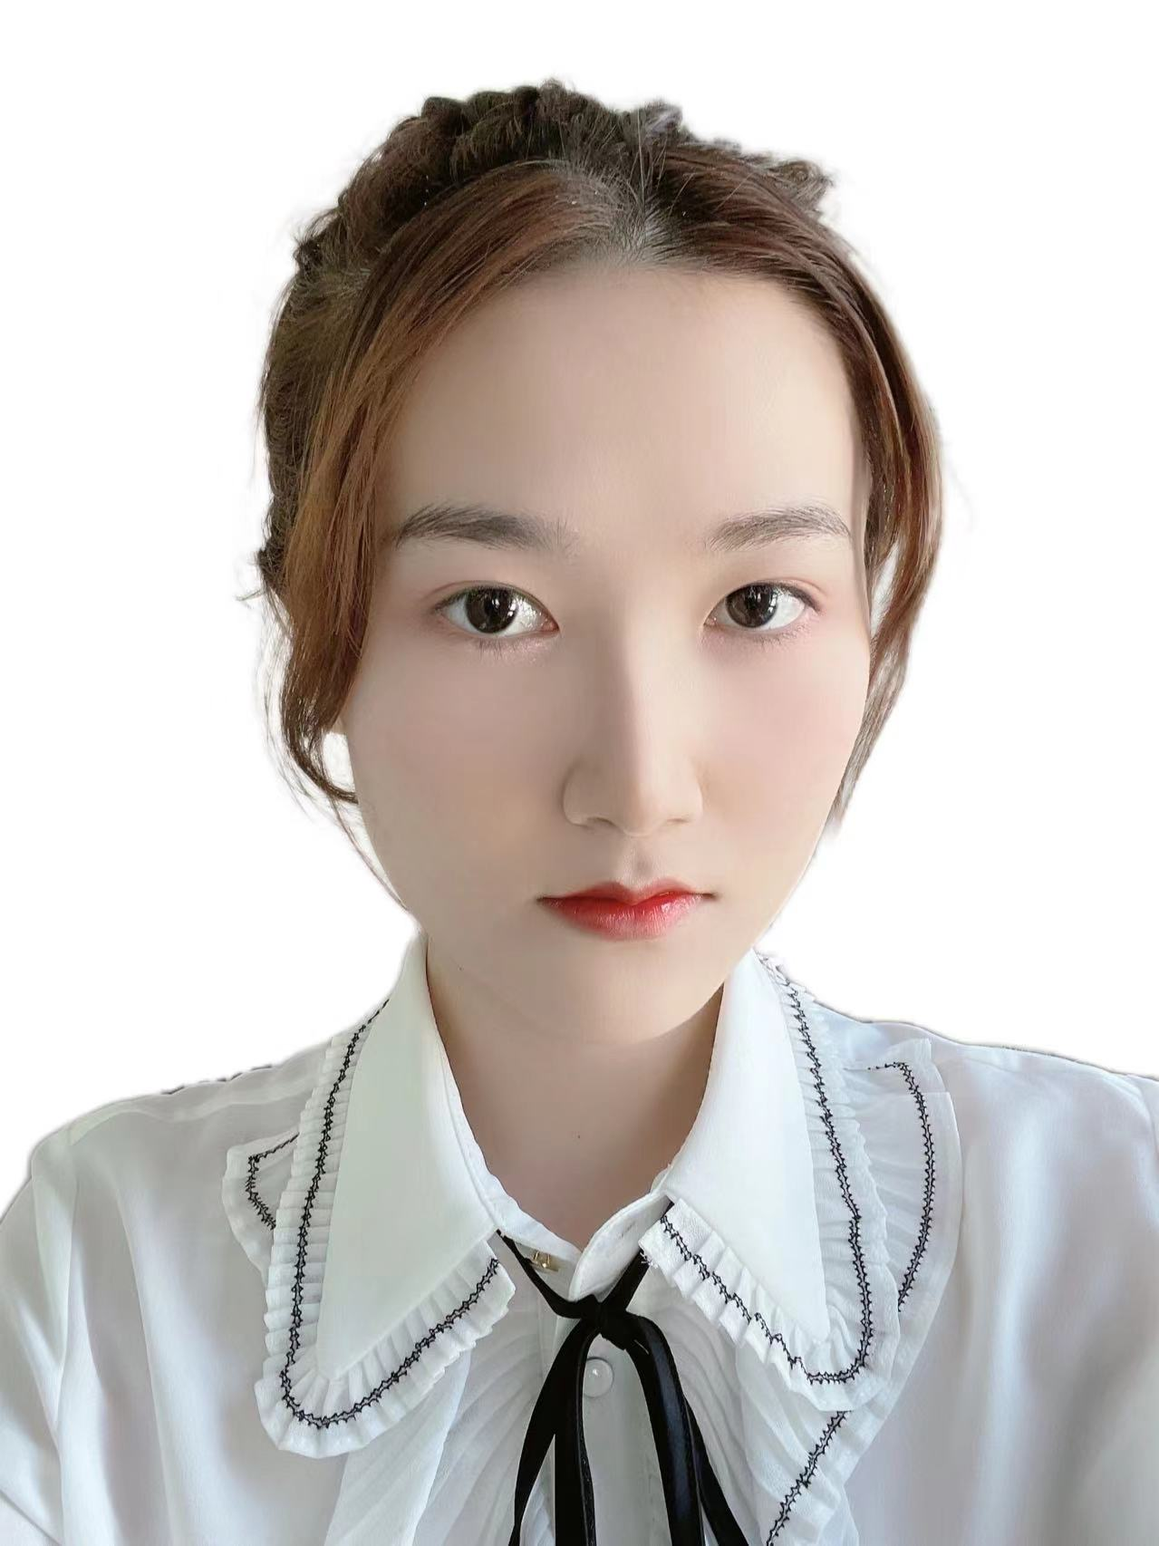
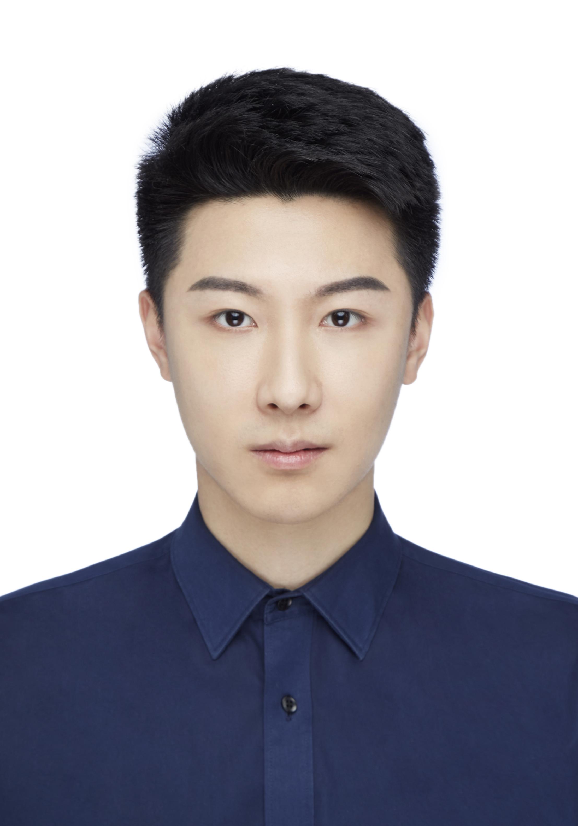
Members
Roy Yu
Lucia Tan
Tong Su
Tong Li
University Of Toronto
2nd Year Student
Economics and Statistics
University Of Toronto
2nd Year Student
Economics and Statistics
University Of Toronto
2nd Year Student
Computer science and Statistics
University Of Toronto
1st Year Phd
Statistics
CAN DEV

Slide 3
Insights overview
Gender
Underrepresented groups
Companies
01
02
03
Gender variations under different occupations and job level.
Proportion in different job level and salary differences
Promotion rates gap in the last decade
Diversity in high position and low position jobs
CAN DEV

Slide 4
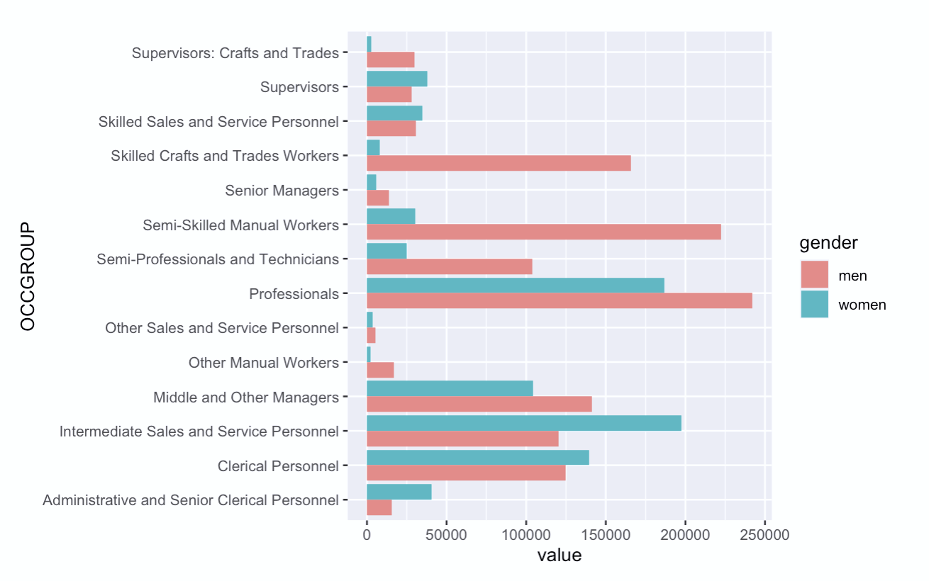
1. Genders
Occpations
Type your headline here
Men are dominated in most jobs
Women only dominated in service and clerical jobs
There is a significant employment inequality between male and female employees
4
CAN DEV

Slide 5
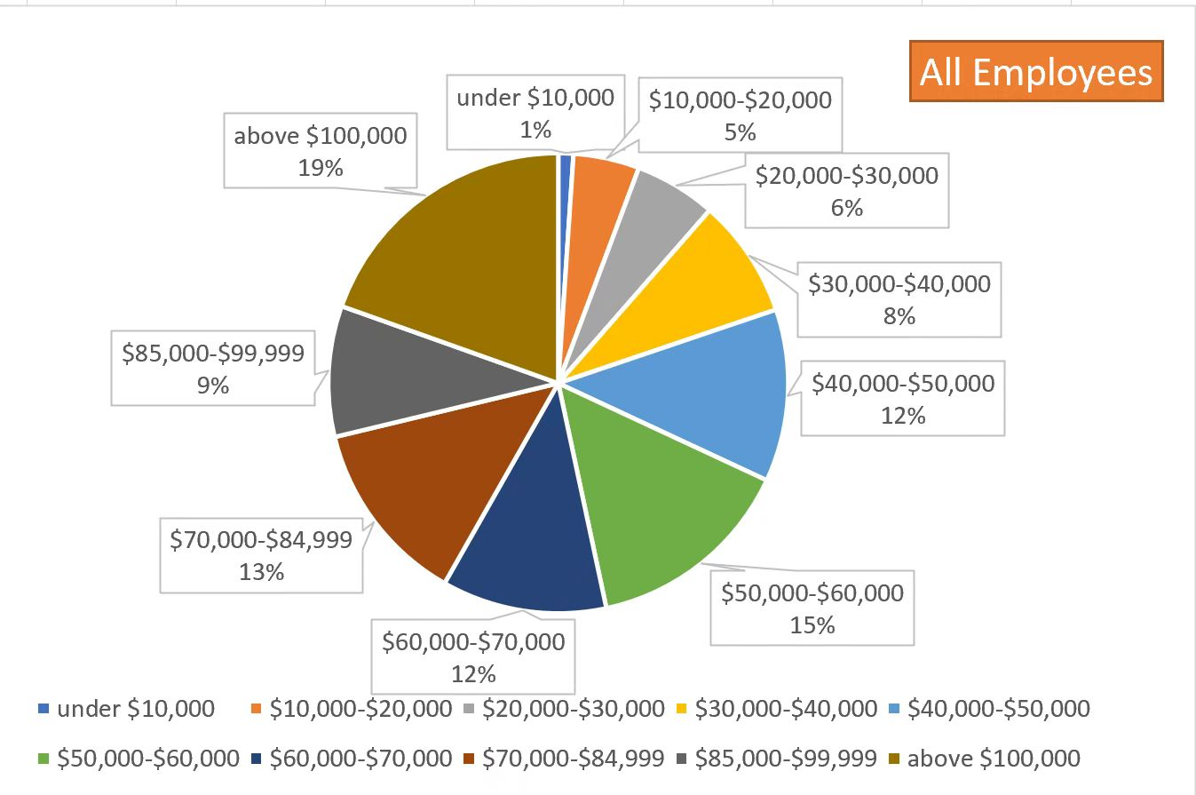
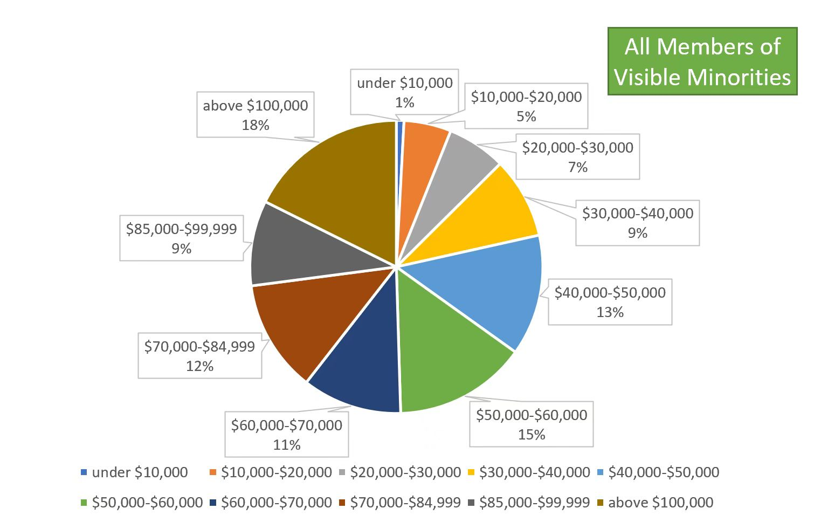
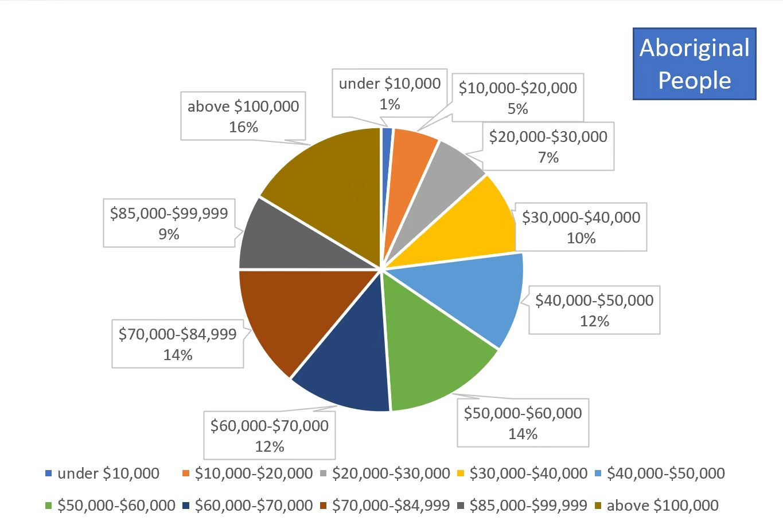
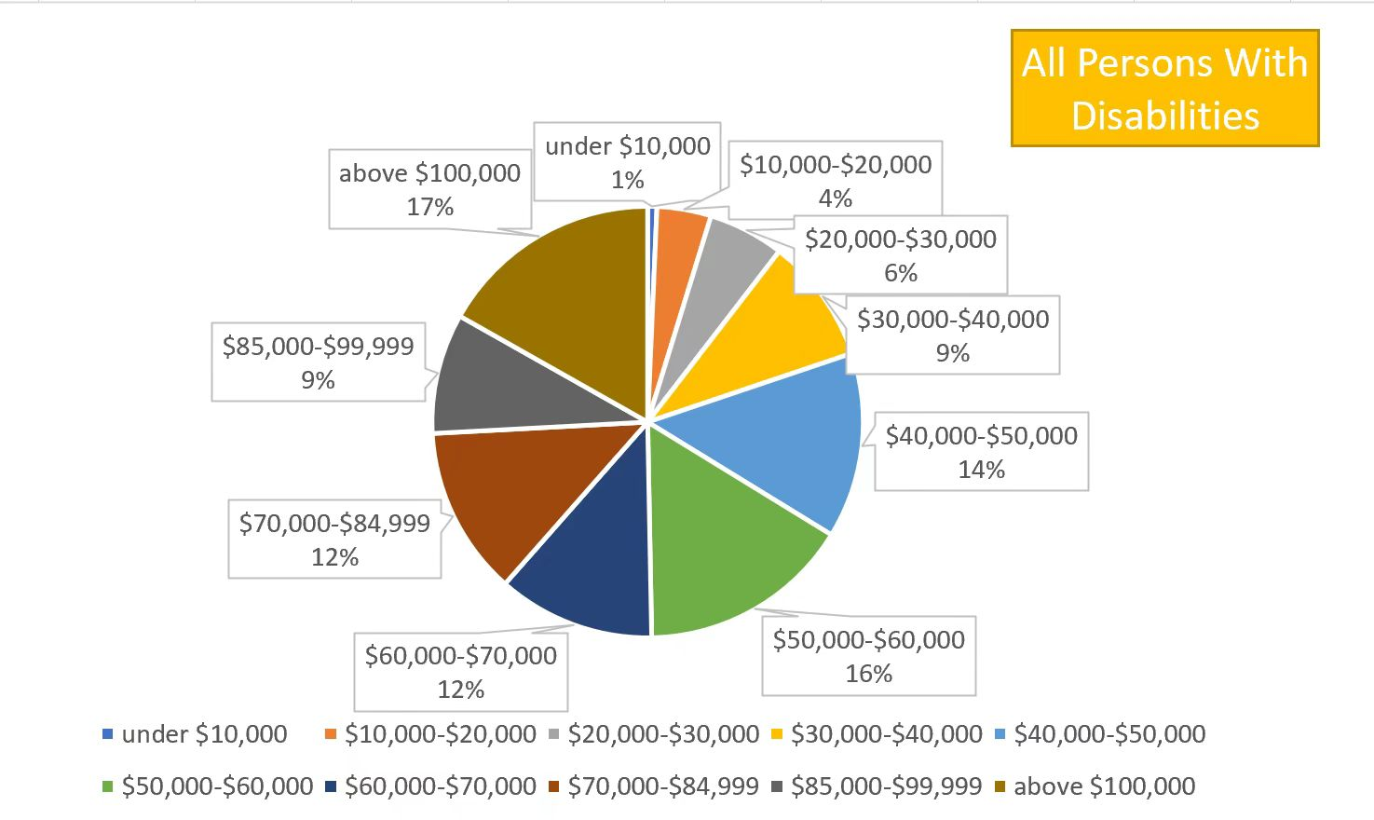
2. Underrepresented Groups
Salaries
Salaries
All Employees
Type your headline here
CAN DEV
5

Slide 6
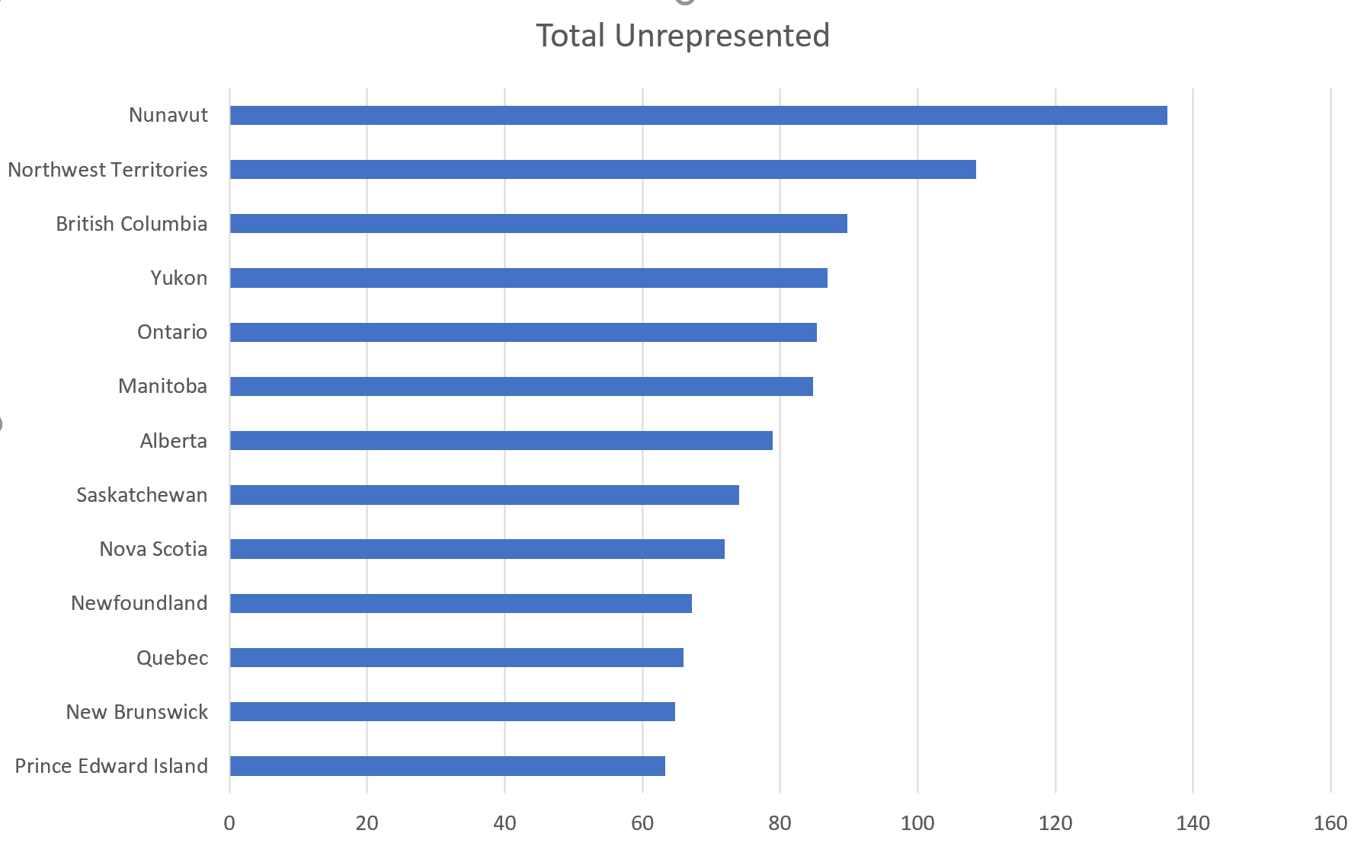
2. Underrepresented Groups
Region
Unrepresented Groups:
Women, Persons With Disabilities, Aboriginal People, Visible Minority
Most Diverse Region: Nunavut
Least Diverse Region: P.E.I
Provinces in the west coast is more diverse than provinces in the east cost

Slide 7
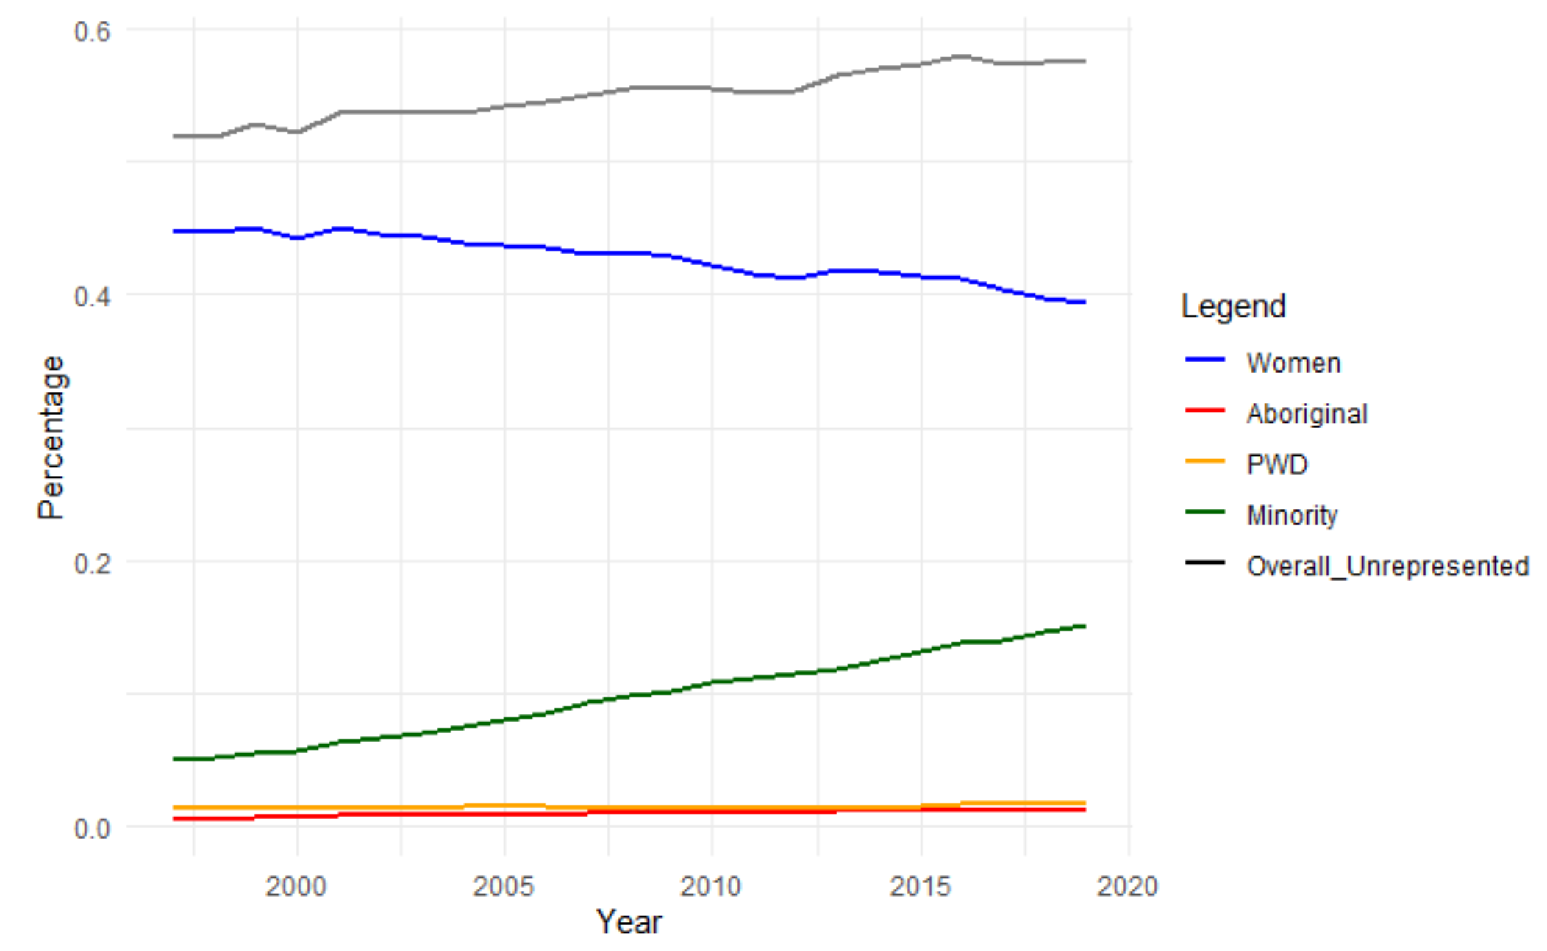
2. Underrepresented Groups
Proportion trend
Aboriginal
(The proportion) Remained almost constant
Minority employee
(The proportion of minority employees keep) Increasing over the last two decades
Women employee
There is a downward trend in (the proportion) women employees in the market
Employee with disability
(The proportion) Recently start to increase

Slide 8
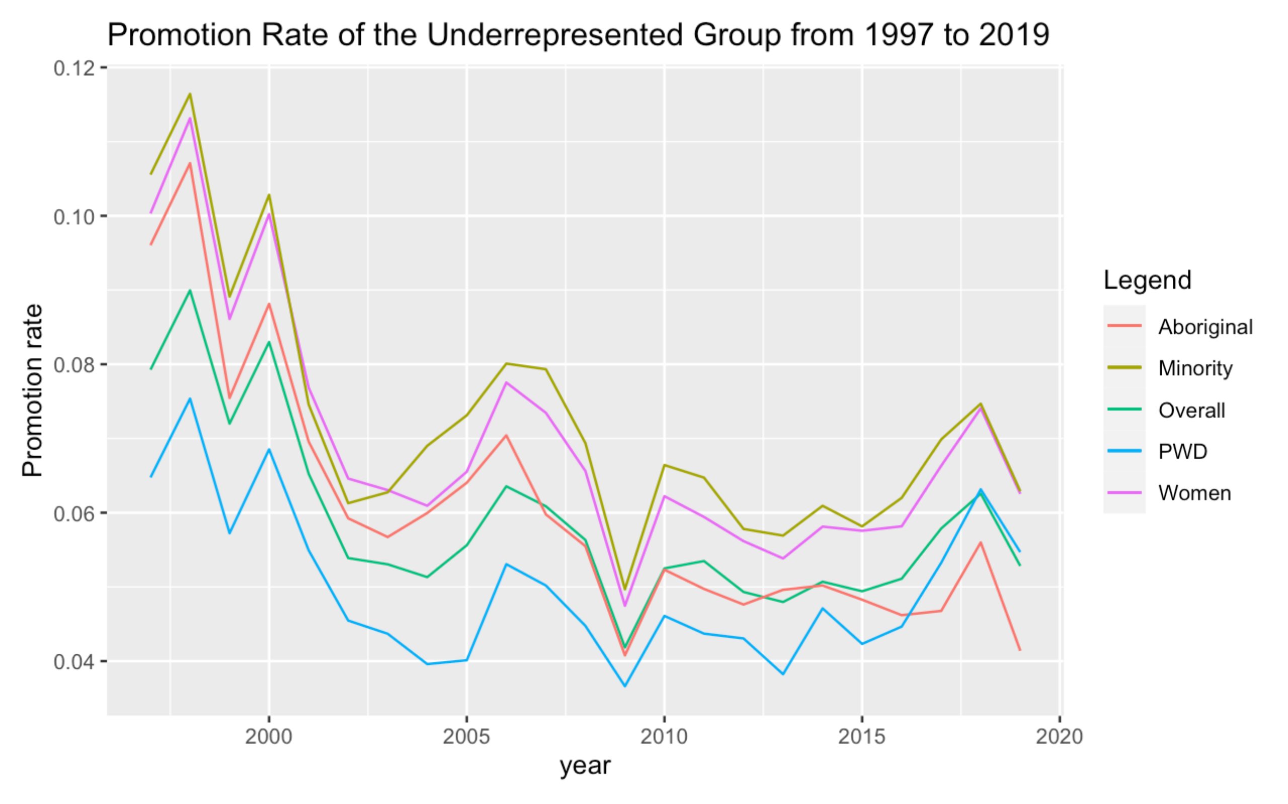
2. Underrepresented Groups
Proportion trend
Promotion rate of underrepresented group generally follows the trend of overall rate
This means that the high terminateion rate of underrepresented group is not due to low promotion rate

Slide 9
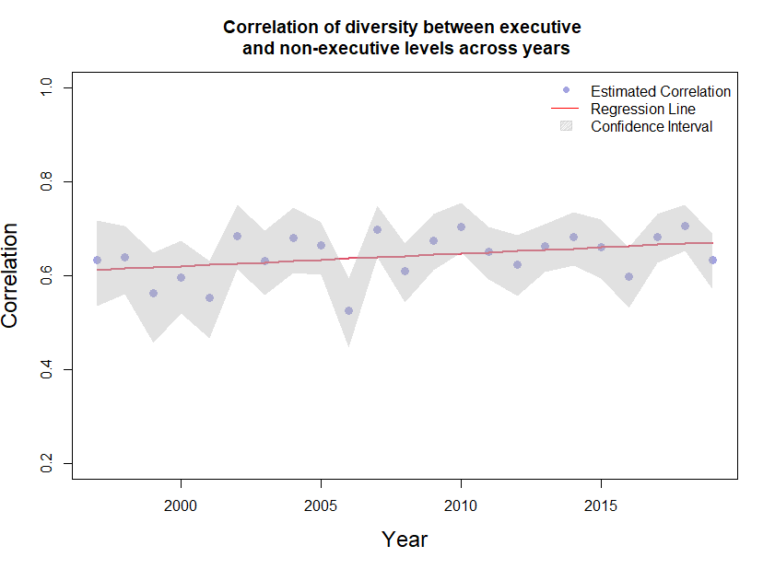
3. Companies
Diversity in different job levels
Type your headline here
The correlation between executive (managers) and non-executive levels is roughly the same in each year with slight variation.
The correlation is fairly strong. It is significantly greater than 0 according to its confidence interval estimation.
CAN DEV
7

Slide 10
Thanks for watching
CAN DEV

